Slide 1
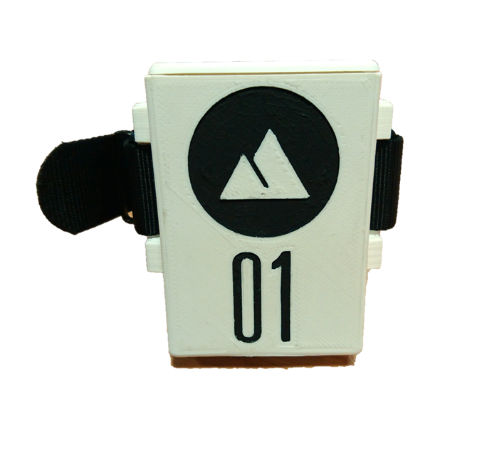
Climber Timer
2nd Year EEE Project
Alexander Prescott
Archit Sharma
Benjamin Biggs
Bonne van Oordt
Tamara Elmani
Thomas Poskitt
Tomasz Białas

Slide 2
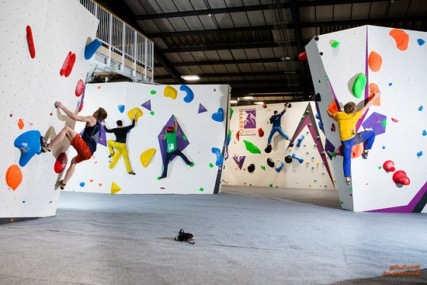
Problem Overview
People at climbing centres need a way to easily time their climbs and log the climbs they have completed
Cannot interfere with the climbing ability of a person
Should be able to retrofit onto existing walls

Slide 3
Business Model
Advertise to climbing centres across the UK
Product easily adapts to any design of climbing centre
Centres can market product to users with subscription model/pay-per-use
Item | Unit Price (£)
Wristband | 8
Tag (per 50) | 40
Software Package | 50
Yearly Maintenance | 15

Slide 4
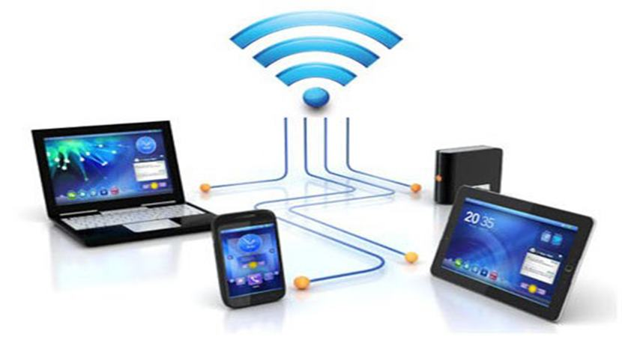
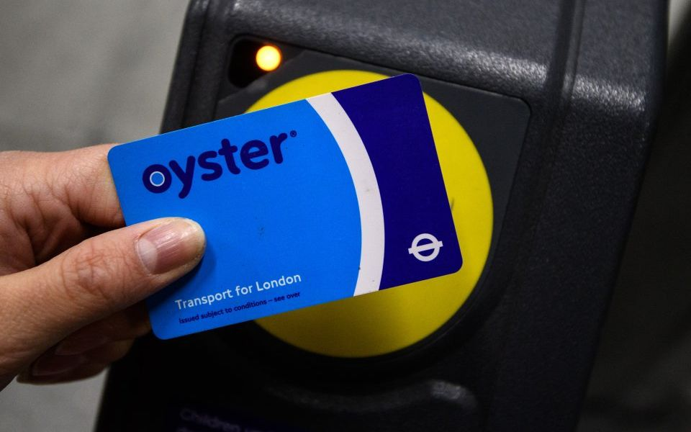
Hardware Development: Wi-Fi & RFID
Wi-Fi range: 100m
Typical used to cover small buildings
Station & router draw 100mA
RFID range: 2-4cm
Tag can be without power
Power transfer using 13.56Mz radio waves
Read and write capabilities
Passive part can be compact
Notes:
Wifi can communicate wirelessly with a range of up to 100m
Typical use can cover the range of a small building despite obstructions such as walls
Both ends of a wifi connection can draw about 100mA whilst communicating
RFID (radio frequency identification) has a range of a few centimetres
One end of the connection doesn’t need a power supply. It draws power from the 13.56Mz radio waves of the active side
Information can be written and read from the passive part
The passive part can be very flat because it is only a coil of wire and a tiny microchip

Slide 5
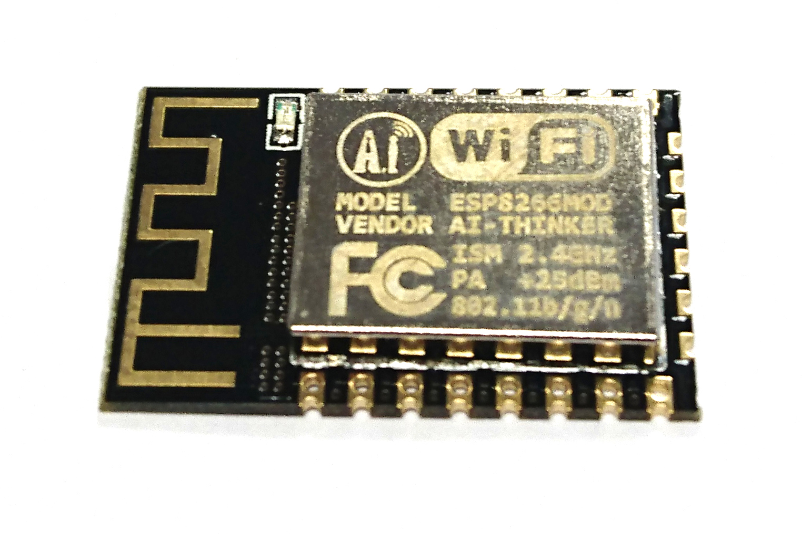
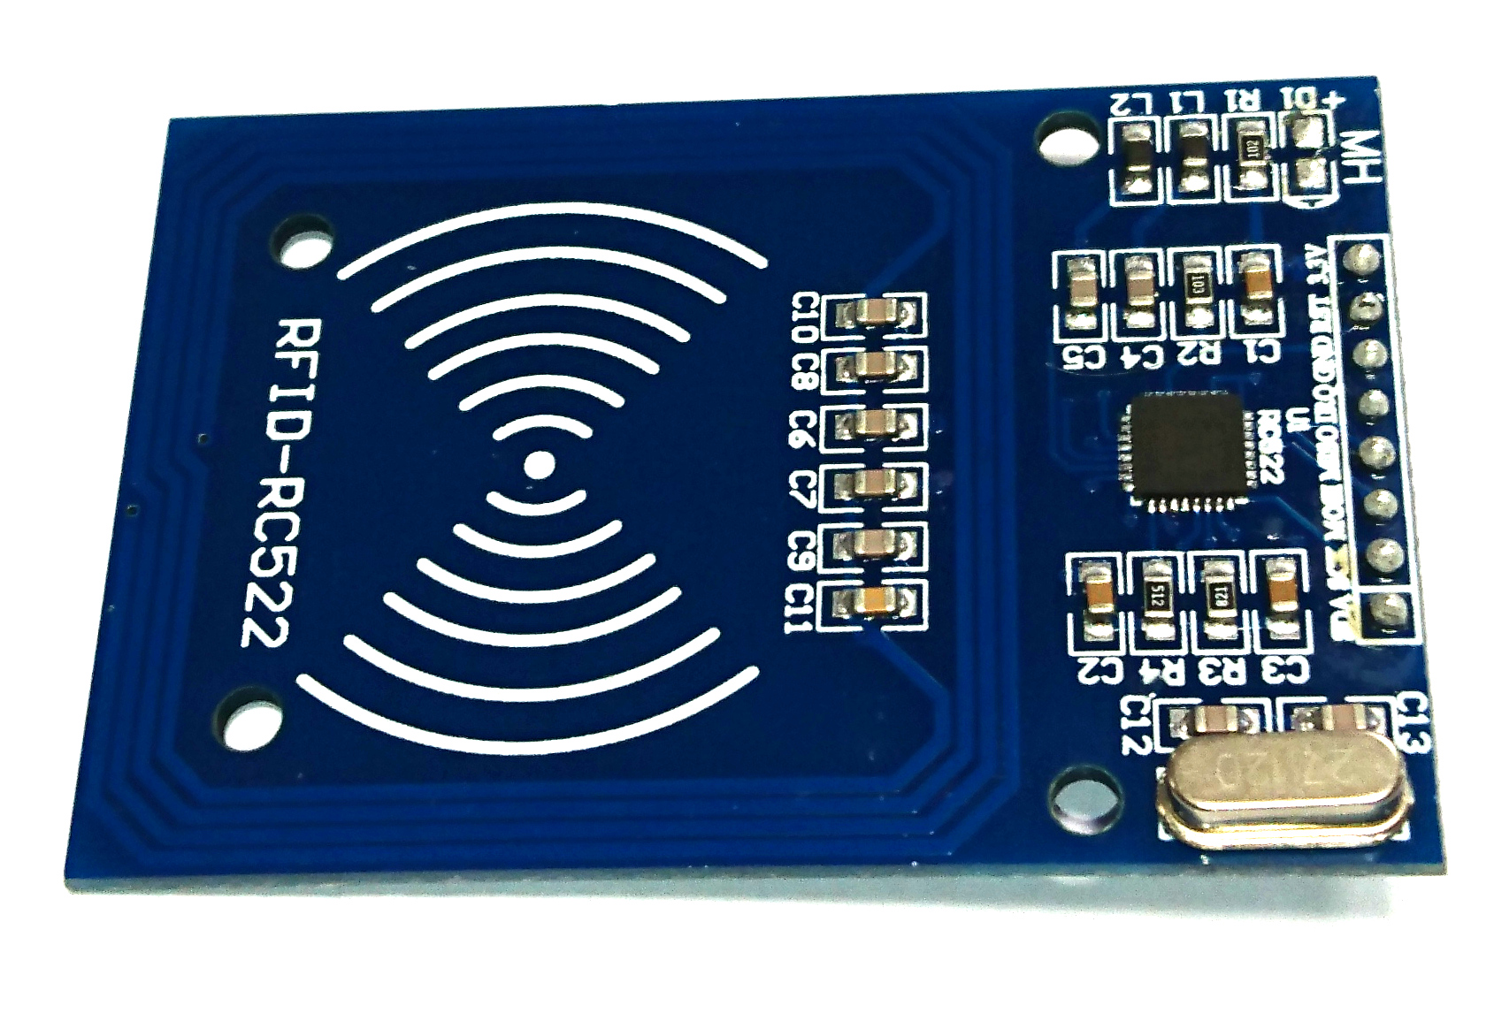
Hardware Development: Core components
Microcontroller & Wi-Fi IC: ESP8266
Has built-in Wi-Fi stack
Libraries available for networking
ESP12 module
RFID tag reader: MFRC552
Popular RFID/NFC IC
Readily available development kits
Notes:
Microcontroller and WiFi connectivity IC: ESP8266
Has built-in WiFi stack – plz explain wifi stack
Libraries available for networking, both through SDK and Arduino platform
ESP12 module
RFID tag reader: MFRC552
Most popular RFID/NFC IC on the market
Readily available development kits

Slide 6
Hardware Development: Task Overview
Record ascent time to nearest 100ms
Auditory confirmation of successful scan
Upload the data to server
4 hours on a single charge
Unobtrusive case
Rechargeable
Notes:
The hardware specifications:
Read a wall mounted tag and record the time to the nearest 100ms
Notify the climber that a tag has been successfully read with a buzzer
Upload the data recorded over wifi as soon as possible
Last for at least 4 hours on a single charge but the longer the better
The case must be unobtrusive for the climber, ideally as small as possible
Must be easily rechargeable

Slide 7
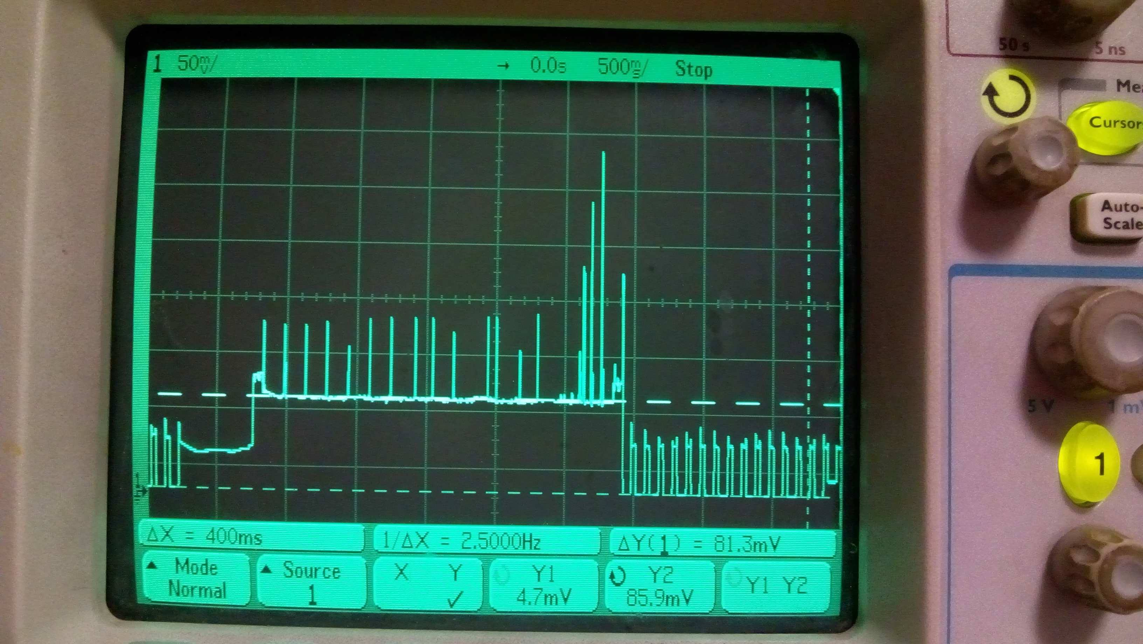
Hardware Development: Power Efficiency
Wi-Fi modem active when data transmission required
Polling of RFID reader required instead of interrupt
~85mA to ~12mA average current consumption
INSERT PIC OF OSCILLOSCOPE
Notes:
Mainly power efficiency related
System is put to sleep at 10Hz, ~30% duty cycle
WiFi modem only activated when data transmission required (read data, NTP sync, ...)
Polling required due to incomplete interrupt output from MFRC522
Unconventional WiFi stack implementation on same core and libraries scheduling conflicts require workarounds
Result: power consumption decreased 7x
From ~85mA to ~12mA average current consumption
Battery life increased from … to ~20hours on single charge

Slide 8
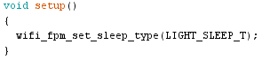
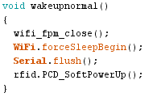
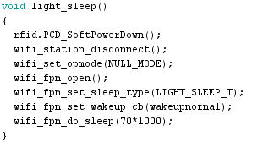
Hardware development: Sleep
Sets the sleep type to light sleep
Restart RFID reader to check for card
Send the RFID and Wi-Fi to sleep
Notes:
Sets the sleep type to light sleep
Restart the RFID components every time it wakes up using callback function
Send the RFID and Wi-Fi to sleep

Slide 9
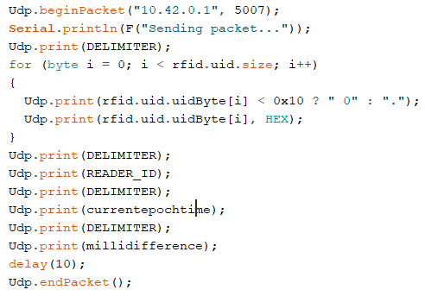
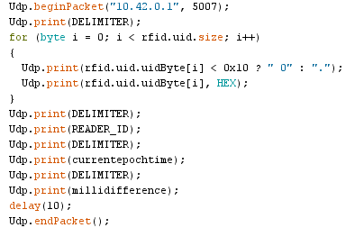
Hardware Development: UDP Transmitter
Specify an IP address and port
Print information to packet
This snippet of code sends:
Tag ID
Wristband ID
UNIX Timestamp
100s Milliseconds
Notes:
Sending data over UDP is fairly simple
Specify an IP address and port
Print information to packet
This snippet of code sends:
Tag ID
Wristband ID
UNIX Timestamp
100s Milliseconds

Slide 10
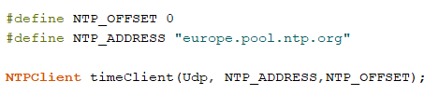
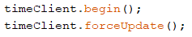
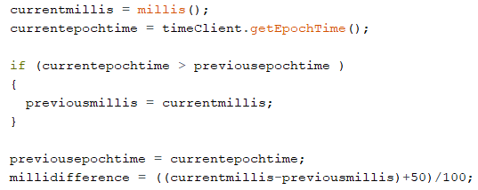
Hardware Development: Network Time Protocol
Gets time server address & creates timing object
Forces timer to update
Gets the UNIX timestamp
Uses internal counter to work out millisecond difference
Notes:
NTP is designed to synchronise the clocks of computers over a network
This will allow accurate timing of problems
Clock will sync with network every 12hours to prevent drift
Sends a more comprehensive timestamp for very little extra processing power
makes processing of packets easier
Performing timing calcs on esp or running a timer would drastically increase the amount of time the esp needs to be “awake” and therefore draws more power

Slide 11
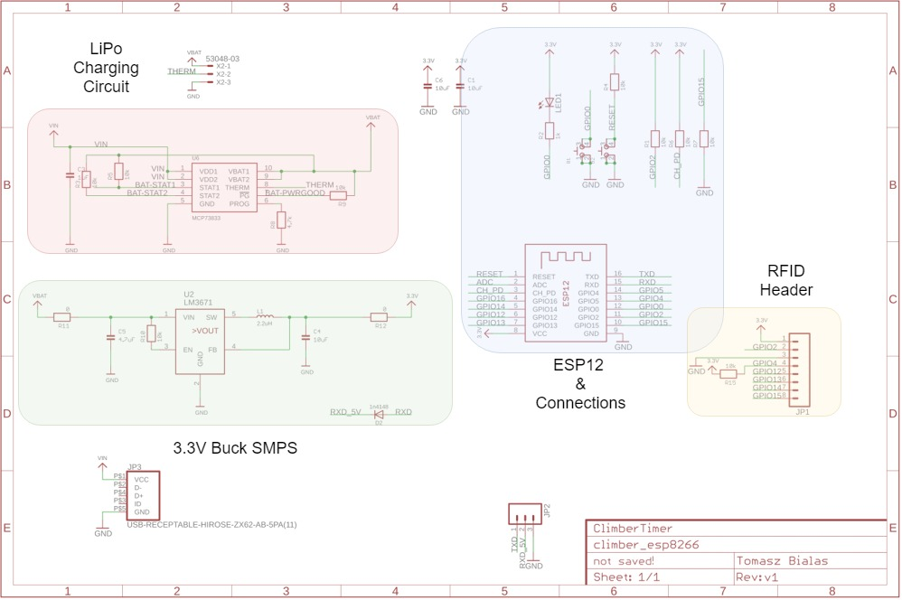
Hardware Development: System schematic
Notes:
ESP12 breakout core
Based on Adafruit Huzzah design https://github.com/adafruit/Adafruit-Huzzah-ESP8266-Basic-Breakout-PCB
Rechargeable battery powered system
Lithium-Polymer for high energy density / 300mAh capacity
MCP73833 battery management IC included for charging
Buck SMPS
Much better efficiency than linear voltage regulator
600mA tolerance of whole system for RF/WiFi current spikes
Texas Instruments LM3671 SMPS
Strict component guidelines to follow

Slide 12
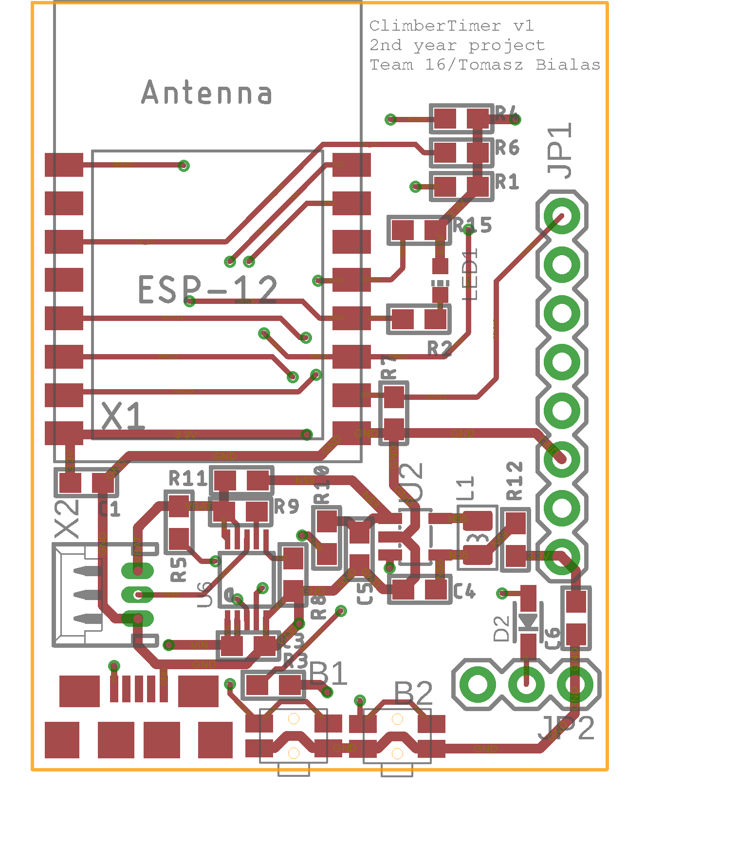
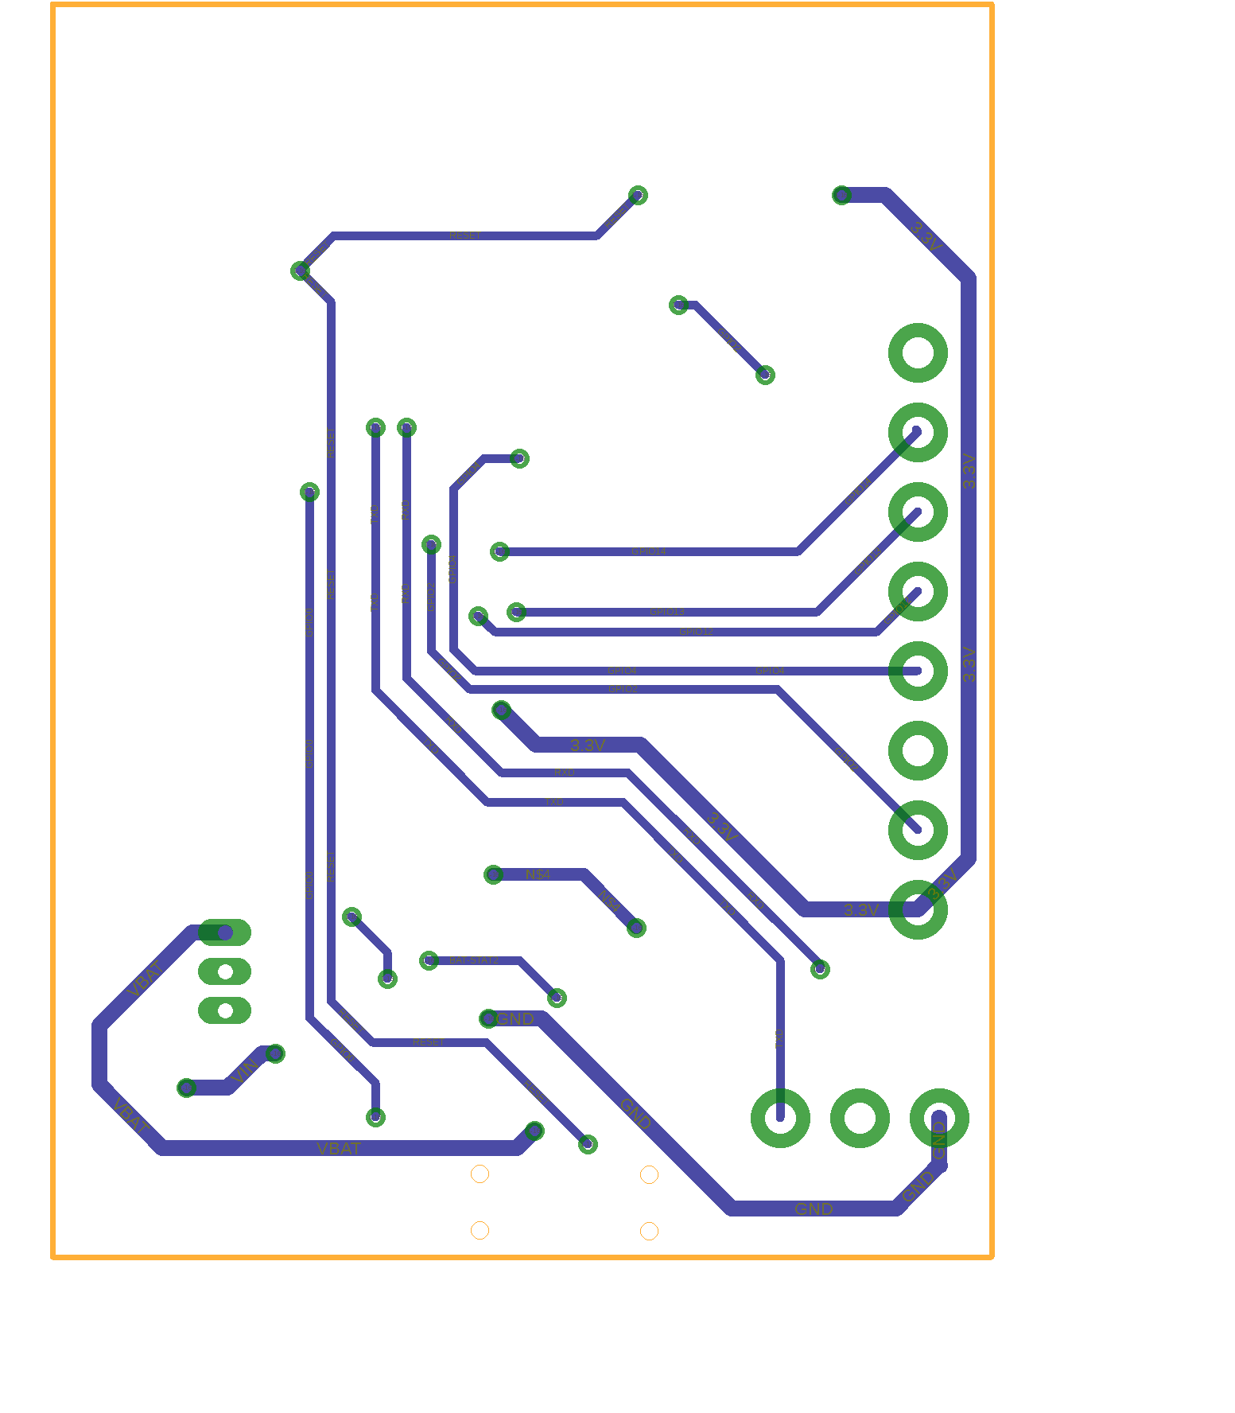
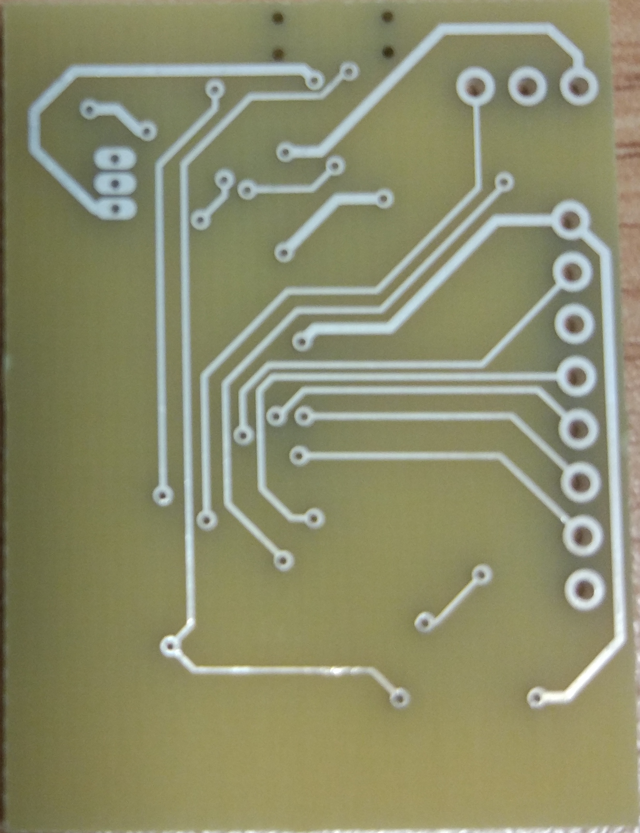
Hardware Development: PCB
Notes:
Physical layout
Needed to be physically small to fit on wrist
Need to fit RFID reader and battery
Keep antennas away from rest of system to avoid interference
Manufacturer Design Rules compliance
Trace thickness, drill dimensions, pads/tracks clearance, etc
Depends on manufacturer
Power considerations
Power trace thickness increased to ensure no voltage drops on RF/WiFI current spikes

Slide 13
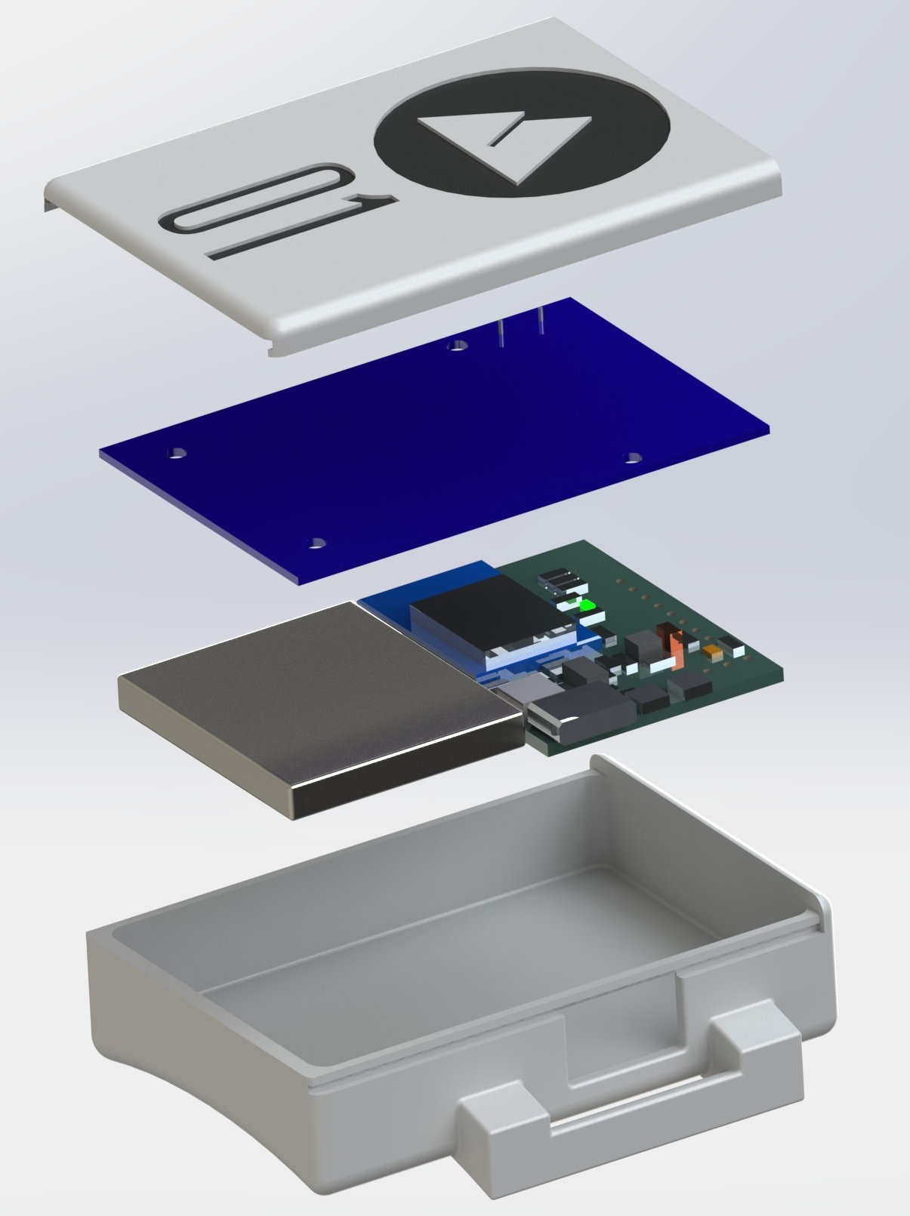
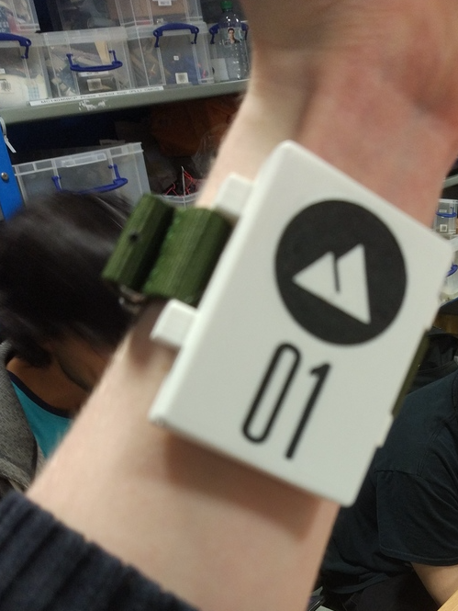
Hardware Development: Enclosure
Notes:
The model was created using solidworks to make sure all components would fit together
Model was then used to 3-D print a case for rapid demonstration purposes
Considered common tech products developed by industrial designers so
A minimalist, somewhat futuristic aesthetic was chosen
logo and tag ID are easily visible to avoid confusion, in practice a part like this would be injection molded

Slide 14
Software Development: Task Overview
Receive & parse data packets from wristband to database
Develop webserver to access database and display information to user
Server should store account data securely
Server should be able to receive packets from multiple wristbands
Data should update with a minimal latency of 30s
Notes:
Receive data packets to from wristband
Parse received data and store in database
Develop a webserver that retrieves information from the database and displays it on a webpage accessible by the user
Server should securely store account data
Server should be able to receive multiple data streams at once
Data should update with a minimal latency of 30s

Slide 15
Software Development: Network Overview
Front end
Back end
Admin
Raspberry Pi
Server
PHP/HTML
Webpage
PHP
User
MariaDB Database
Python
WiFi
Wristband

Slide 16
Software Development: Database Structure
User
Problem
User_problem
Tag
Wristband
Setter
user_id | username | name_first | name_last | wristband_id | password | admin
problem_ number | start_id | finish_id | grade | setter_id | colour | zone | set_date | strip_date
user_id | problem_ number | attempts | sends | fastest_ send
tag_id | tag_ number | login | user_ connect
Legend
Primary Key
Foreign Key
Unique
wristband_id | wristband_number | tag_id | start_time
setter_id | name_first | name_last
Notes:
Explain primary keys and foreign keys
Discuss why table is layed out as such

Slide 17
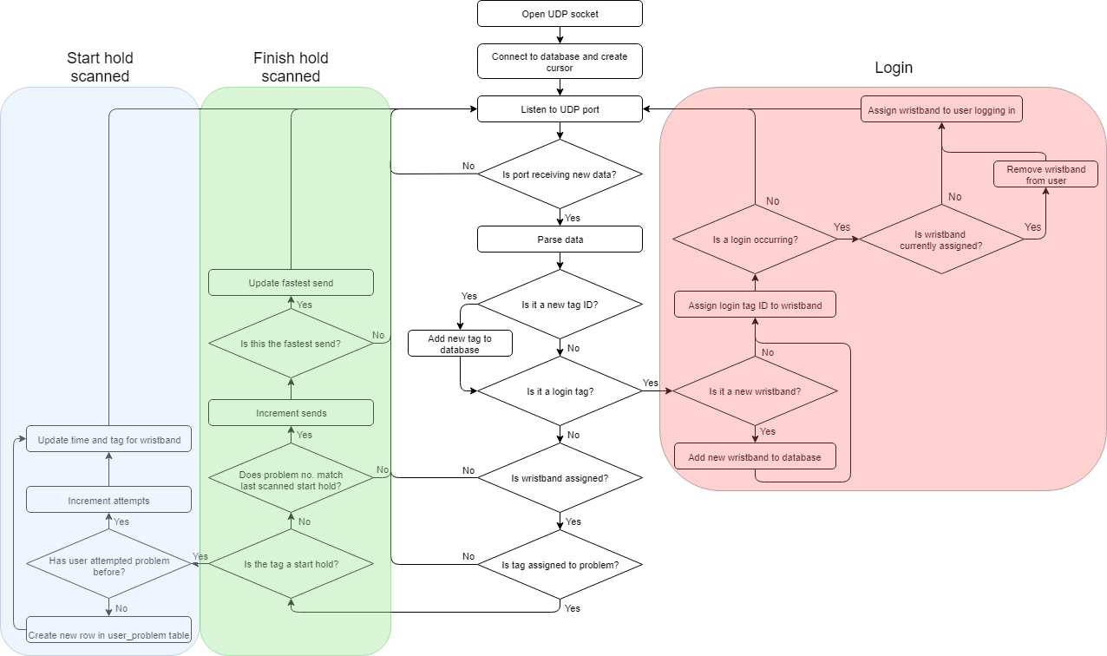
Software Developments: UDP Receiver
Notes:
Receiver creates a UDP socket to receive data packet from wristband
Connection made to mariadb server, cursor created to interact with database
Repeated packets are sent in case any are lost, if more than one of the same data packets is received, the repeats are ignored
Always listening on port when no data is being processed
Discuss how the login process works
Discuss discuss basic logic start/finish hold

Slide 18
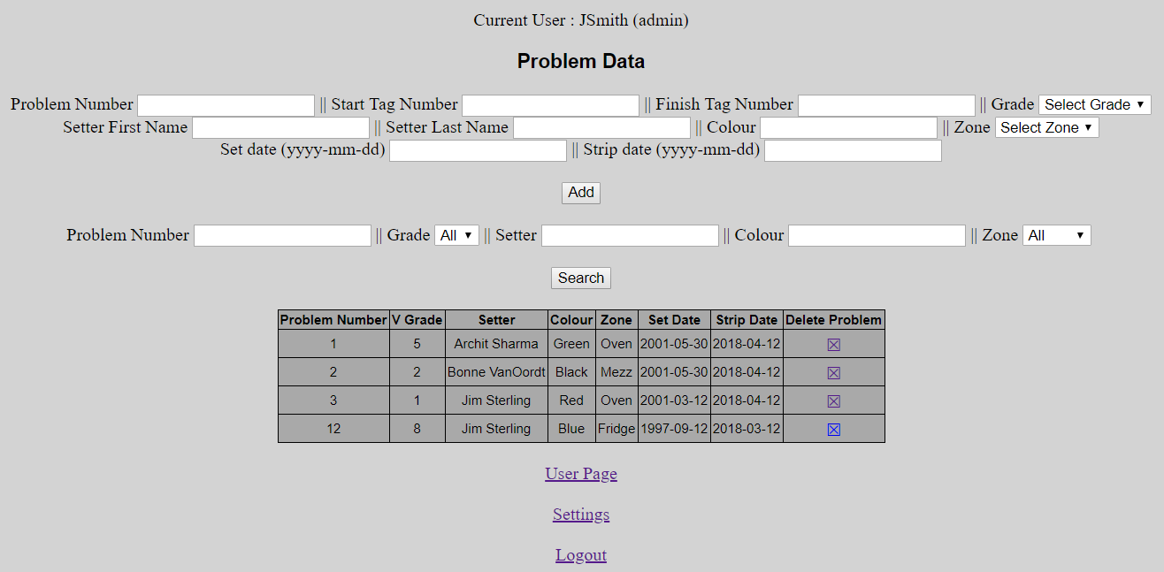
Software Development: Website
Uses an Apache webserver on the Raspberry Pi
Can perform MySQL queries with dynamic conditions
Has admin users that can alter sections of the database
Would like a/some pic/s of website

Slide 19
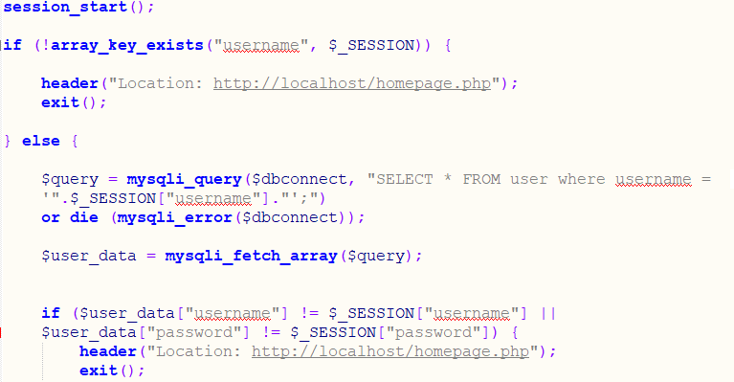
Software Development: Security
Preventing unauthorised login via the URL bar
Preventing characters being used to manipulate the database without permission
Notes:
Preventing unauthorised login via the URL bar
Preventing escape characters from being used in bar inputs to manipulate the database
Use a hash function so user passwords can’t be easily gotten from hackers (this needs to be done ASAP, any old hash function will do)

Slide 20
Summary
Light, unobtrusive design
Rechargeable battery with long battery life
Fast data upload
Can retrofit to any climbing wall
User-friendly website

Slide 21
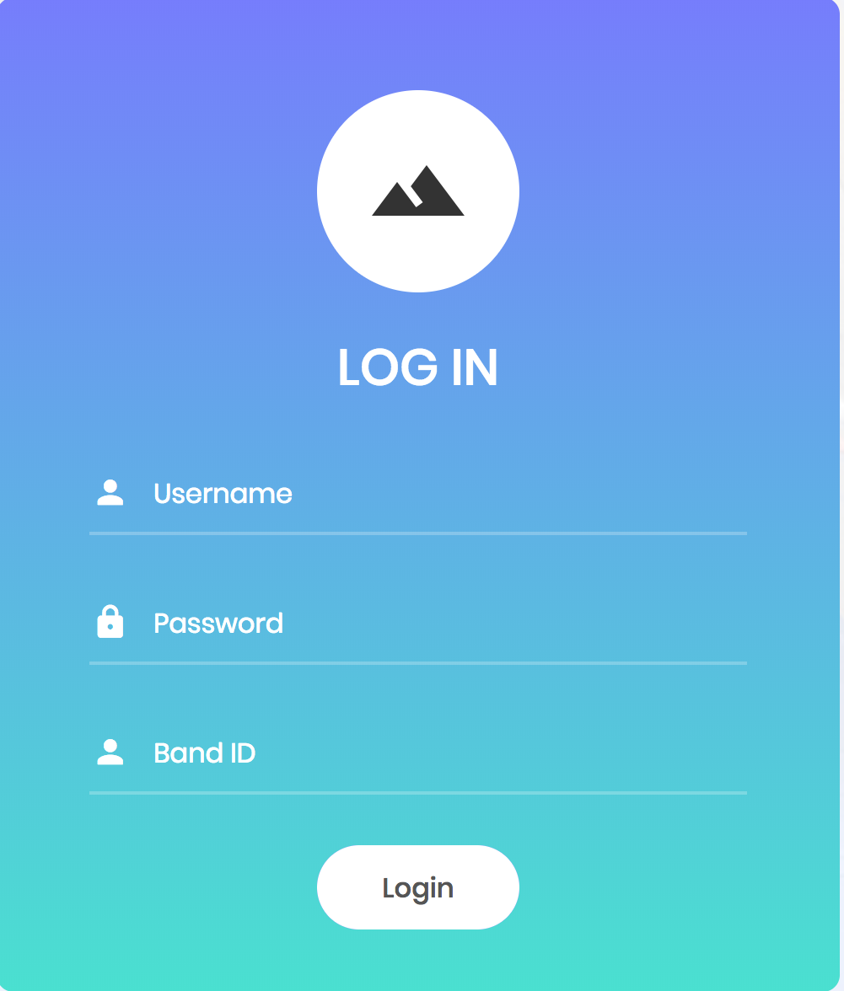
Project Expansion: Website Improvements
Make a partner app so users can access the database on their phones
Increase security by using a hash function
Add a comments section
Improve the CSS and brand aesthetic
Notes:
Implement hash function for password storage security (don’t let this be a website improvement, just have it in)
Make a partner app so users can access the database on their phones
Add a comments section for users to discuss problems
Improve the CSS for a more aesthetically pleasing and user friendly website

Slide 22
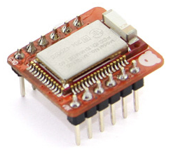
Project Expansion: Reduce Power Consumption
Use the ESP8266 deep sleep function to draw micro amps
Low power Bluetooth module instead of Wi-Fi
Notes:
Use the ESP8266 deep sleep function to draw only a few micro amps whilst not connecting to the internet
Requires another timer because the ESP loses it’s time in deep sleep
Requires the interrupt function of the MFRC522 to work
Could use a nRF51822 Bluetooth Low energy board (pictured)
Bluetooth is lower powered that wifi
This board idles at around 100µA and will sustain about 10mA during a Bluetooth connection
The range of Bluetooth is worse but may still be suitable for the application

Slide 23
Project Expansion: Reduce Weight & Size
Integrate RFID reader components with custom PCB
Embed the RFID’s coiled antenna in to case
Invest in a custom sized LiPo battery
Optimise the PCB design
Use a thinner PCB material
Increase layer number
Choose smaller components
Removable programming header
Notes:
Don’t use the RC522 development board but integrate the RC522 chip on to the existing PCB
Embed the RFID’s coiled antenna in to the case to make the case thinner
If mass manufactured, invest in a custom sized (and potentially flexible) LiPo battery
Optimise the PCB design
Use a thinner PCB material
Use more layers to reduce the surface area
Choose smaller components where possible
Make the programming header removable

Slide 24
Questions?

